Slide 1
Optimal Matching Portal
A Web Application for Student Project Allocation

Slide 2
What is the Optimal Matching Portal?
A system to collect data
Students and Project Proposers
Housing Allocation Problem
Preferences on one side
Matched to each other with optimal satisfaction

Slide 3
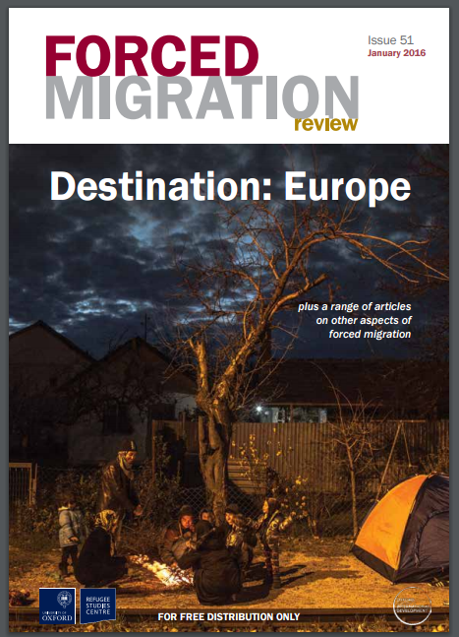

Existing Systems

Slide 4
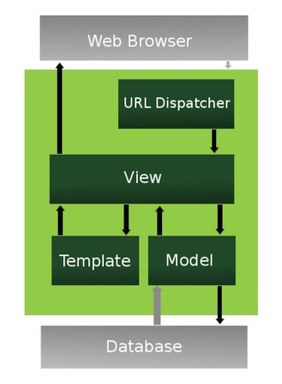
Django
A framework for web development
Abstracts elements
Uses Models, Views and
Templates
Database itegration
Security against SQL
XSS, CSRF

Slide 5
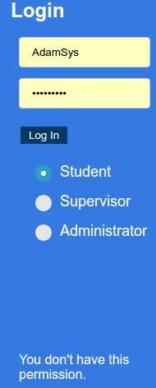
Django Example – Login View
URL renders a HTML template
Login submits a form POST
Details authenticated in
view
Successful login is verified
User is redirected
Failures displayed on screen

Slide 6
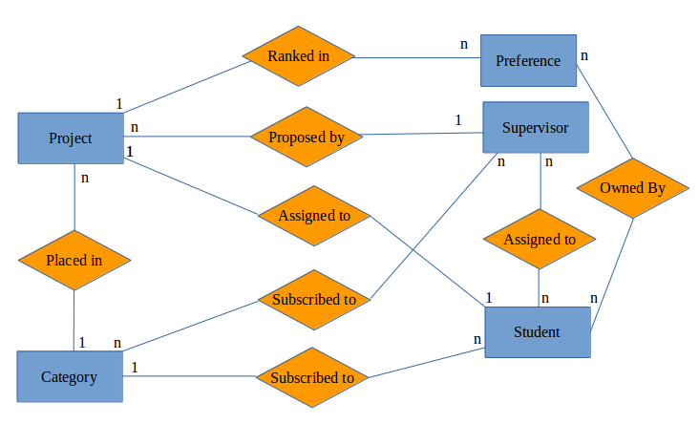
Database Design
SQL Lite database provided by Django

Slide 7
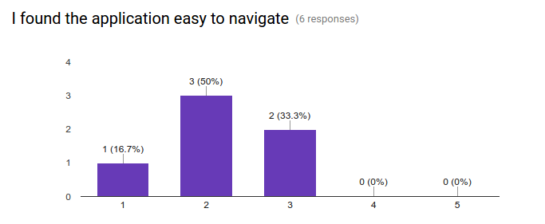
User Evaluation
Direct Observation
Users complete a list of tasks
Fill out a Google survey after

Slide 8
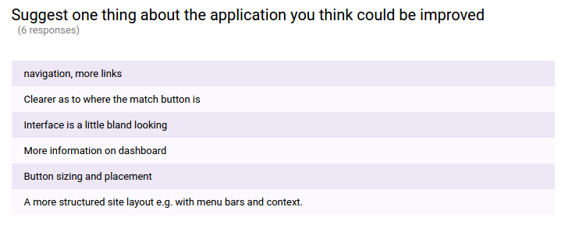
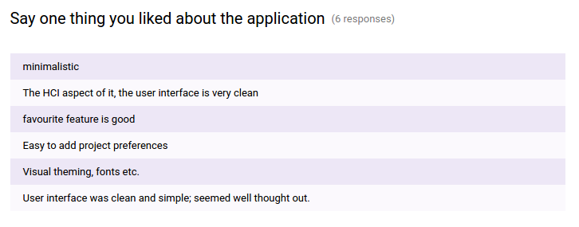
Feedback

Slide 9
Conclusion
Faced a lot of challenges
Excellent learning experience
Learned about software design process
Future Work:
  More Robust Matching Algorithm
  Collection of matching statistics
  User Interface Tweaks

